Slide 1
Writing and Posting Opportunities for Successful Clinical Recruitment and Retention

Slide 2
Introductions
Matt Neuwirth
Senior Vice President of Business Development
Enterprise Medical Recruiting
Survey Source:
MDLinx/PracticeMatch

Slide 3
Objectives
Better understand what information grabs the attention of candidates
Learn how to better write and post job opportunities for easy “scanning”
Learn when and how candidates are looking at job opportunities

Slide 4
Many Expect to Seek a New Job within 5 Years
N=243
Q: Do you expect to look for a new position in the future?

Slide 5
Most Expect to Relocate
Q: If you are in the job market, would you relocate for this new position?

Slide 6
Makeover Your Postings
Components of a Good Job Description
Attention Grabbers
Factors to Retain Attention
Formatting Job Descriptions
Best Media Outlets & Candidate Behaviors

Slide 7
Components
Location
Job Title
Compensation
Benefits
Loan Reimbursement
Community Information
Call Schedule
Practice Information
Position Requirements
Notes:
Components of a job description:
Selling points for the job
Call Schedule if a positive selling point
Info about practice (how many physicians, etc.)
Service population
Position requirements
These are some of the components that we all know are important to job descriptions – Location, Job Title, etc. Sometimes the Call Schedule isn’t the best in the world. Other times the benefits that are offered with the position outweigh the lack of compensation. Or the work / life balance of the location adding with the potential for a doctor to move home can make up for a shortage of benefits.
The strongest selling points are what you will utilize for your …. Title.

Slide 8
Attention Grabbers
Title
Location
Compensation
Specialty
Benefits
Notes:
Attention Grabbers:
Title
Location, specialty, compensation if above average or other attention grabbing feature
Specialty only included for descriptors:
Outpatient Only
Traditional
General
Invasive
Not all job boards have all the subspecialties available so you will want to keep that in mind for very specialized positions.

Slide 9
Attention Grabbers
First Capture
Location (city)
Compensation
Benefits
Call Schedule
Referral Base
Work / Life Balance
Position Requirements
Board Certification
Years of Experience
State Licensure
Special Training
Practice Information
Size
Ownership
Single or Multi Specialty
Community Description
Notes:
List items that will grab the doctors attention first
Compensation and Benefits (these terms are not interchangeable)
Loan Repayment Location
Call Schedule Referral base
Secondary: Important, but not what is going to get the physician to necessarily pick up the phone.
List position requirements (what you are looking for in a physician) after selling the position to the doctor
Board Certification Years of experience State Licensure
Practice Information
Number of Physicians Support staff Special equipment
Community Description
Amenities Local attractions Cost of living
Housing School ratings
I spoke with an acquaintance who told me he doesn’t include comp and benefits because they are all negotiable and he considers it fluff for a job description.
But we need to look at our candidates and what draws their attention and the interest. With that in mind, I’m going to pass off to Bill to share with you all the what physicians are interested in…

Slide 10
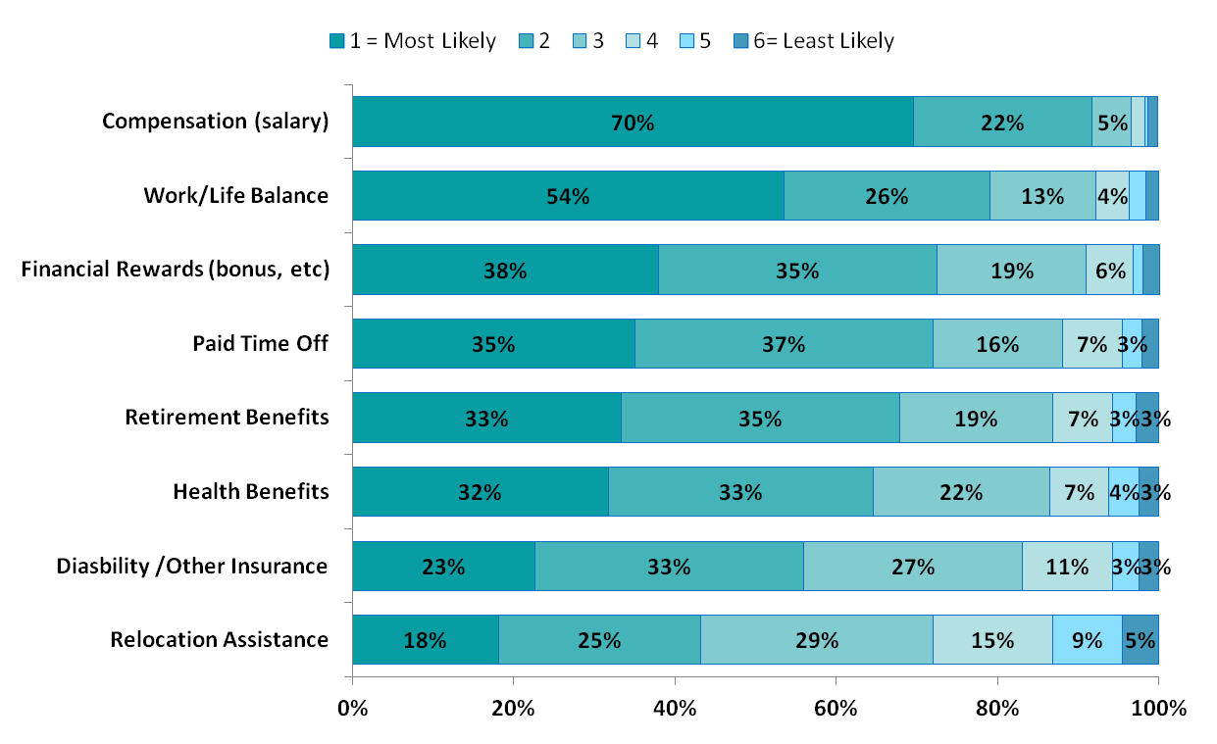
Attracting Attention
Top 2 Box
92%
80%
73%
72%
68%
65%
56%
43%
N=243
Q: When you receive information about a job opportunity, which benefits are most likely to grab and keep your attention? (1=most likely, 6=least likely)

Slide 11
Work Environment
n=243
Q: If you were receiving information about a job opportunity, what aspects of the work environment are most likely to grab and keep you attention? (1 = most likely, 6 = least likely)

Slide 12
Job Description Format
Short paragraphs
Bullet points
No ALL CAPS
No excessive punctuation!?!?!?!?!?!?
Grammar
Ask for action…not a CV
Notes:
Job Description format:
Combination of short (max of 2-3 sentences) paragraphs
Bullet points
NO ALL CAPS
No excessive punctuation?!?!?!?
Grammar and Spelling
Remember to be persuasive, this is what is going to be the first touch to your candidate.
How do candidates read job postings? They scan the postings. They do not read in as great detail as we would like them to believe.

Slide 13
Example I
Hospitalist Opening - Birmingham, AL
Join established and well-run HOSPITALIST group located in Birmingham, Alabama. Over 20 Hospitalists in the group. Hospital employed position. 7 on/ 7 off block schedule for daytime Hospitalists. Competitive base with benefits. Temperate climate year round. The metro area offers many choices for housing and an excellent educational system.
Good or Bad?
Bad ☹
Notes:
This Hospitalist job is short sweet and to the point.
But is it good or bad?
Bad – It is a bunch of run-on sentences smashed together, hiding all the attention grabbers that we have emphasized earlier.

Slide 14
Example I Re-write
Hospitalist Opening - Exceptional Sign-on Bonus - Birmingham, AL
Join an established and well-run Hospitalist group located in Birmingham, Alabama.
Generous competitive base plus productivity
Robust benefits including CME, 401K, loan repayment and relocation
7 on/ 7 off block schedule for daytime Hospitalists with no call requirements
Work 15-18 shifts per month, averaging 16-18 patients per shift
Hospital employed position for 409-bed facility and over 20 hospitalists in group
Birmingham offers a central and convenient location for travel, as well as a temperate climate year round while still experiencing all four seasons. The metro area offers many outstanding choices for housing and has an excellent educational system.
Good ☺
Notes:
Here we have re-written the same ad.
Bulking up the Title with an attention grabber – Exceptional Sign-on Bonus
We took our attention grabbers from being smashed together
Bulleted the components
Listed them by importance to the candidate
Added persuasive descriptors to our attention grabbers
Included some practice and hospital information
Finally, we added a little more meat to the community description to add a location hook to our candidates.

Slide 15
Example II
Family Medicine position employed with recently revamped Hospital in Quincy, IL
A great hospital in a beautiful community is looking for its next Family Medicine physician. In 2011, the Health System was named one of the “100 Best Places to Work in Health Care” by Modern Healthcare magazine. The incoming provider will be joining a group of 45 employed physicians and bring their skills to the sum of specialties. Currently, there is Hospitalist group coverage. Some of the details:
Compensation varies with experience, but is HIGHLY competitive and above median
Sign-on BONUS and Relocation Assistance included!!!
Full benefits including malpractice coverage, CME and vacation
No call
The city of Quincy is located on limestone bluffs overlooking the Mississippi River, and is renowned for its natural beauty, preservation of its exceptional stock of Victorian Era homes, and its highly developed programs in the arts. It has been cited as one of the 50 top small arts communities in the U.S., and one of the top 100 small cities in which to live. In 2010, Forbes Magazine listed Quincy as the #8 Best Small City in the U.S. to Raise a Family. Crime and unemployment are unusually low while recreational facilities and lifestyle amenities are unusually high. The community also offers excellent public and parochial schools, a 2-year public community college, a 4-year private university, two vocational colleges, fine dining, and abundant recreational facilities. It is located two hours from St. Louis, three and a half hours from Kansas City, and four hours from Chicago. Quincy’s Baldwin Field offers six commuter flights daily to St. Louis, and Amtrak provides two round trip passenger trains daily to Chicago.
This truly is a phenomenal position with a great system and a wonderful community. Now is the time to find out if it is the right fit for you!!!
Good or Bad?
Bad ☹
Notes:
Now we have a Neurology posting.
This looks good. It has a lot of information and has highlighted important components with bullets.
Is it good or bad?
Bad – More information is not always best. There is excessive punctuation, bolding and underlining. I know it may seem to make things stand out, but there are a few things to remember.
All caps is yelling online
Formatting changes from site to site

Slide 16
Example II Re-write
Employed Family Medicine position with Recently Updated Hospital in Quincy, IL
A great hospital in a beautiful community is looking for its next Family Medicine physician to join a group of 45 employed physicians and bring their skills to the sum of specialties.
Compensation varies with experience, but is highly competitive and above median
Sign-on bonus and relocation assistance included
Full benefits including malpractice coverage, CME and vacation
No call
The city of Quincy is located on limestone bluffs overlooking the Mississippi River, two hours from St. Louis, three and a half hours from Kansas City and four hours from Chicago. The community also offers excellent education system, fine dining and abundant recreational facilities.
This truly is a phenomenal position with a great system and a wonderful community. Call today to find out if it is the right fit for you.
Good ☺
Notes:
Here we have re-written the same ad again.
Remember when writing a Title, you do not have to have all lowercase letters.
We have also removed quite a bit of information from the description.
Job Postings online are meant to persuade the candidate to email us or pick up the phone and call us. They are not meant to do our job completely.
Understand, all candidates are different and focus on different benefits. Also, every specialty has a different lure…whether that is patient load, referral base, schedule flexibility or support staff. So the key is to make the postings as complete as you can without making it so long that they will not get past the first paragraph.
Let’s take another step deeper into our Candidate’s behavior now, Bill…

Slide 17
Communication Formats
Top 2 Box
71%
62%
31%
30%
19%
12%
7%
N=243
Q: If you were receiving job opportunity information from a potential employer, what communication format are you more likely to open and read to learn more about the position?

Slide 18
Job Opportunity Emails per Week Non job seekers also receive announcements
N=250
Q: Approximately how many emails about job opportunities do you receive in a typical week?

Slide 19
Recruiters Send More than Half of Job Announcements
N=250
Q10: When you receive emails about job opportunities, what sources are they from?

Slide 20
On Which Emails Do You Receive Job Opportunities
N=250
Q: When you receive emails about job opportunities, what sources are they from?

Slide 21
Viewing Behaviors Even those not searching are scanning postings
95%
Vs.
81%
N=250
Q: Do you expect to look for a new position in the future?
Q: Which of the following best describes your approach to job opportunity announcements?

Slide 22
Daily Email Checking is the Norm Evenings are more popular
Day of the Week
Time of Day
56%
N=250
Q: In a typical week, which days of the week do you tend to open emails related to job opportunities?

Slide 23
Job Board Participation Even those not looking are subscribing
N=250
Q: Do you expect to look for a new position in the future?
Q: How many job boards are you subscribed to?

Slide 24
Less than Half of Residents
Receive Career Guidance
N=24 (small sample)
Q: During your residency and/or fellowship training, did you receive any guidance on job seeking (writing a CV, interviews, etc.)? Who did you receive guidance from?

Slide 25
What Did We Learn Today?
Almost half of MDs surveyed expect to change jobs in the next 5 years
Many doctors do not go very far beyond the posting title
Beyond salary, many different benefits are attention grabbers
Geography and work-life balance are leading workplace factors
Better job postings are written for easy scanning
Emails remain a preferred delivery vehicle
Job opportunities are commonly received in either personal or work email addresses
Most read the job opportunity emails any / every day
Evening is the most common time to read the emails – but all are used
Job board use is relatively low (34%)
Higher among those looking for a new position in 1 to 5 years
New grads need help with career guidance/help

Slide 26
Questions?
Thank you for your participation!

